Slide 1
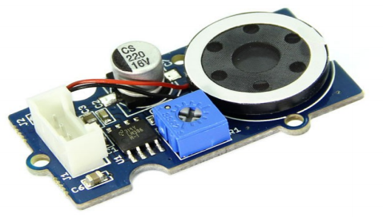
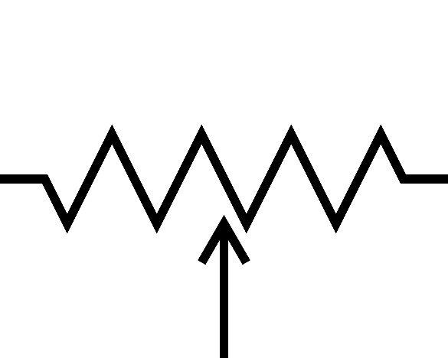
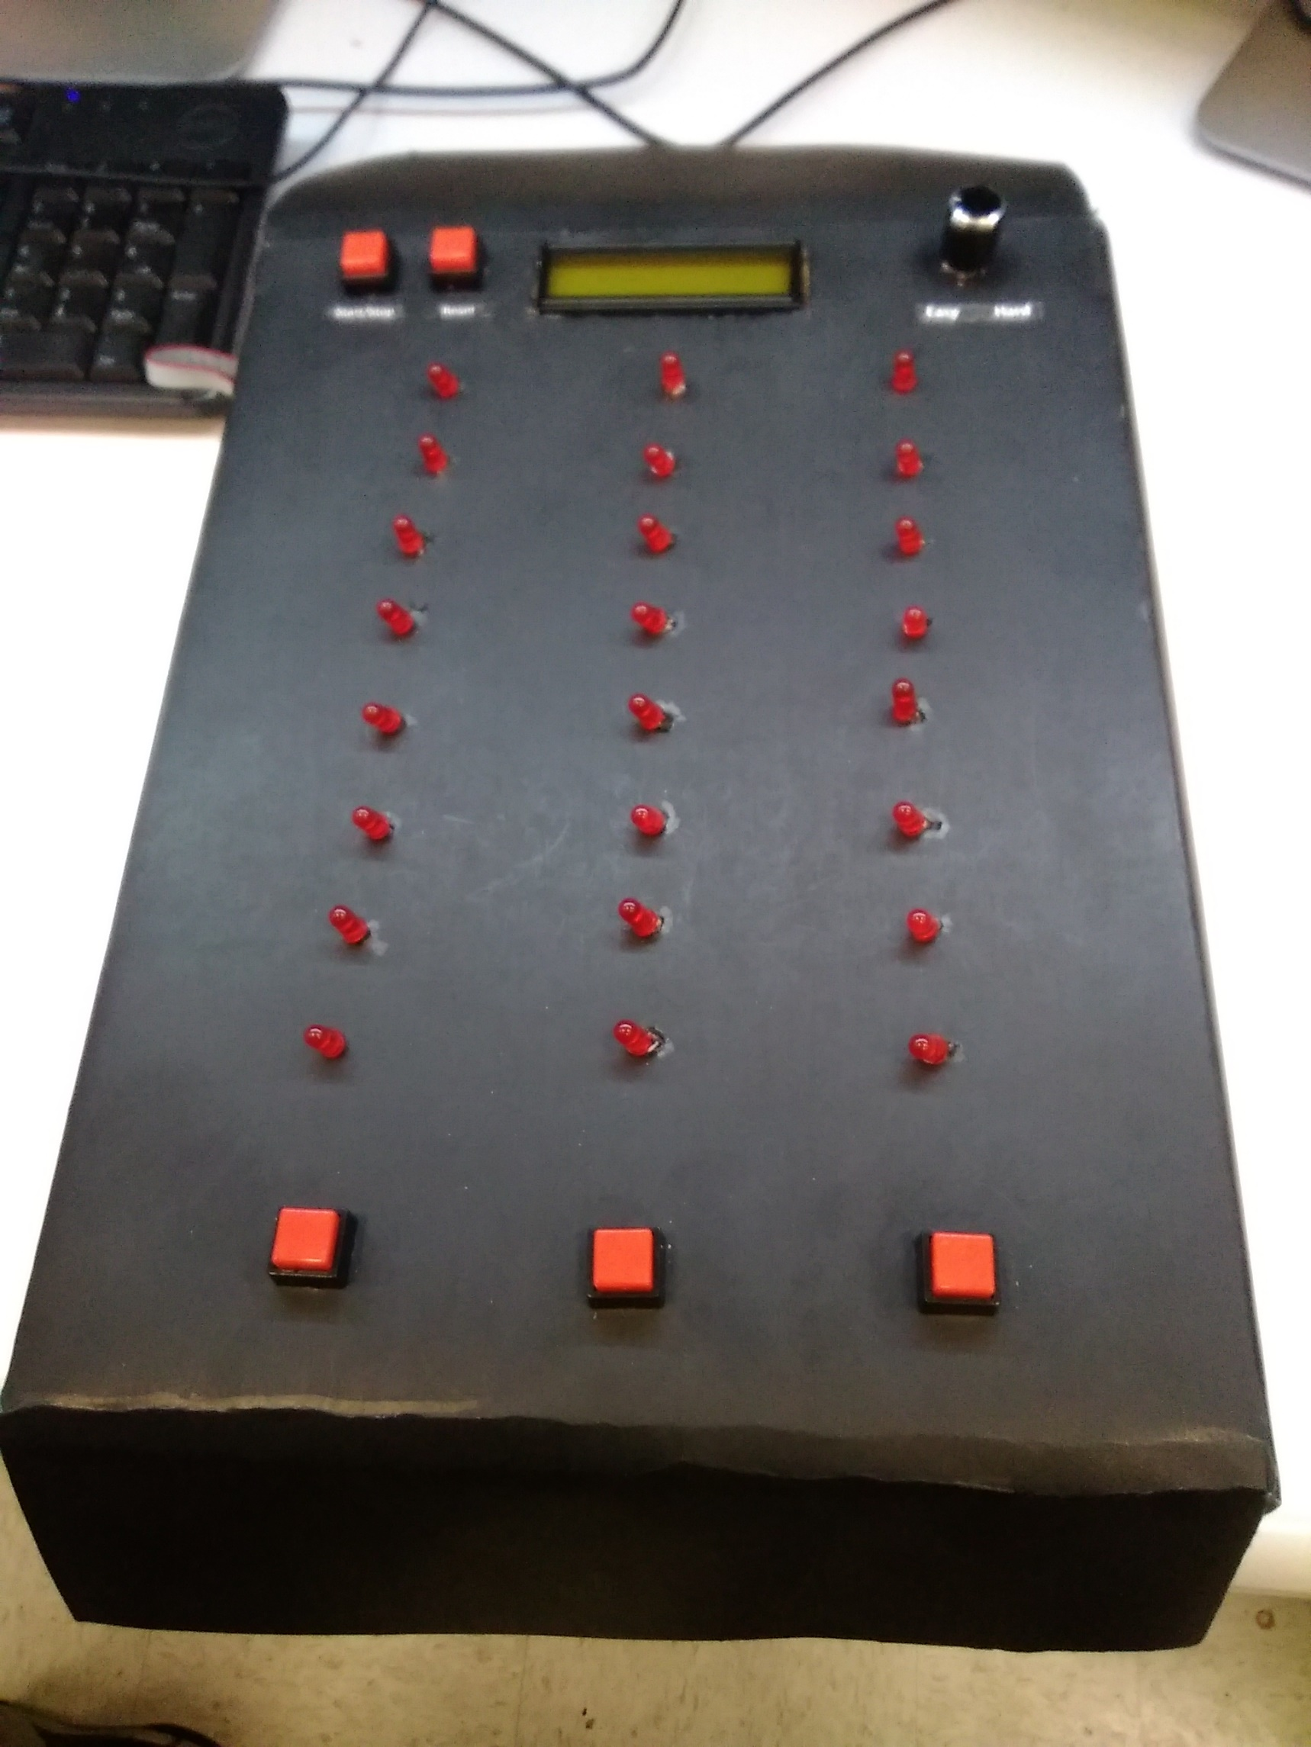
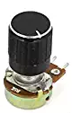
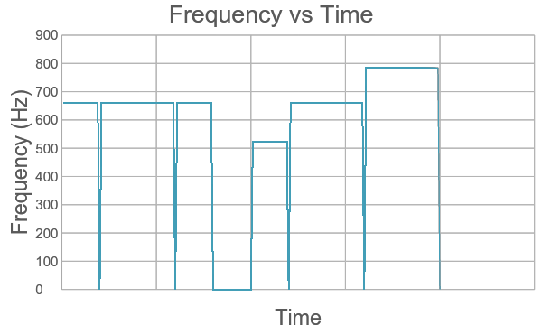
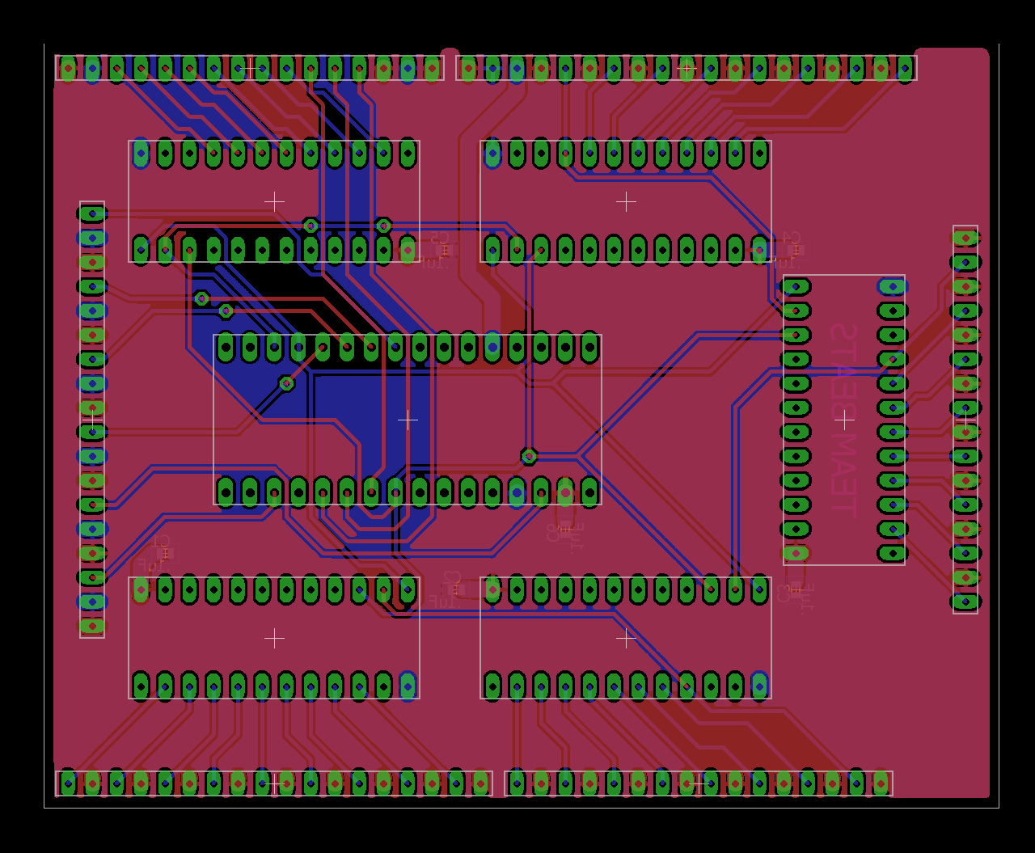
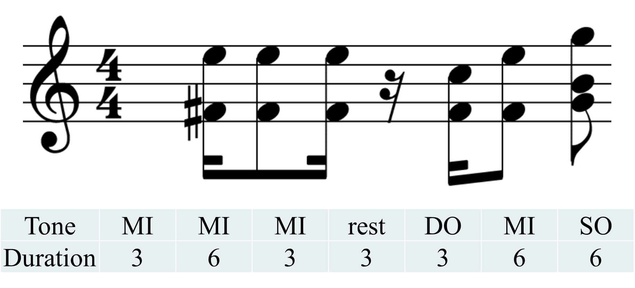
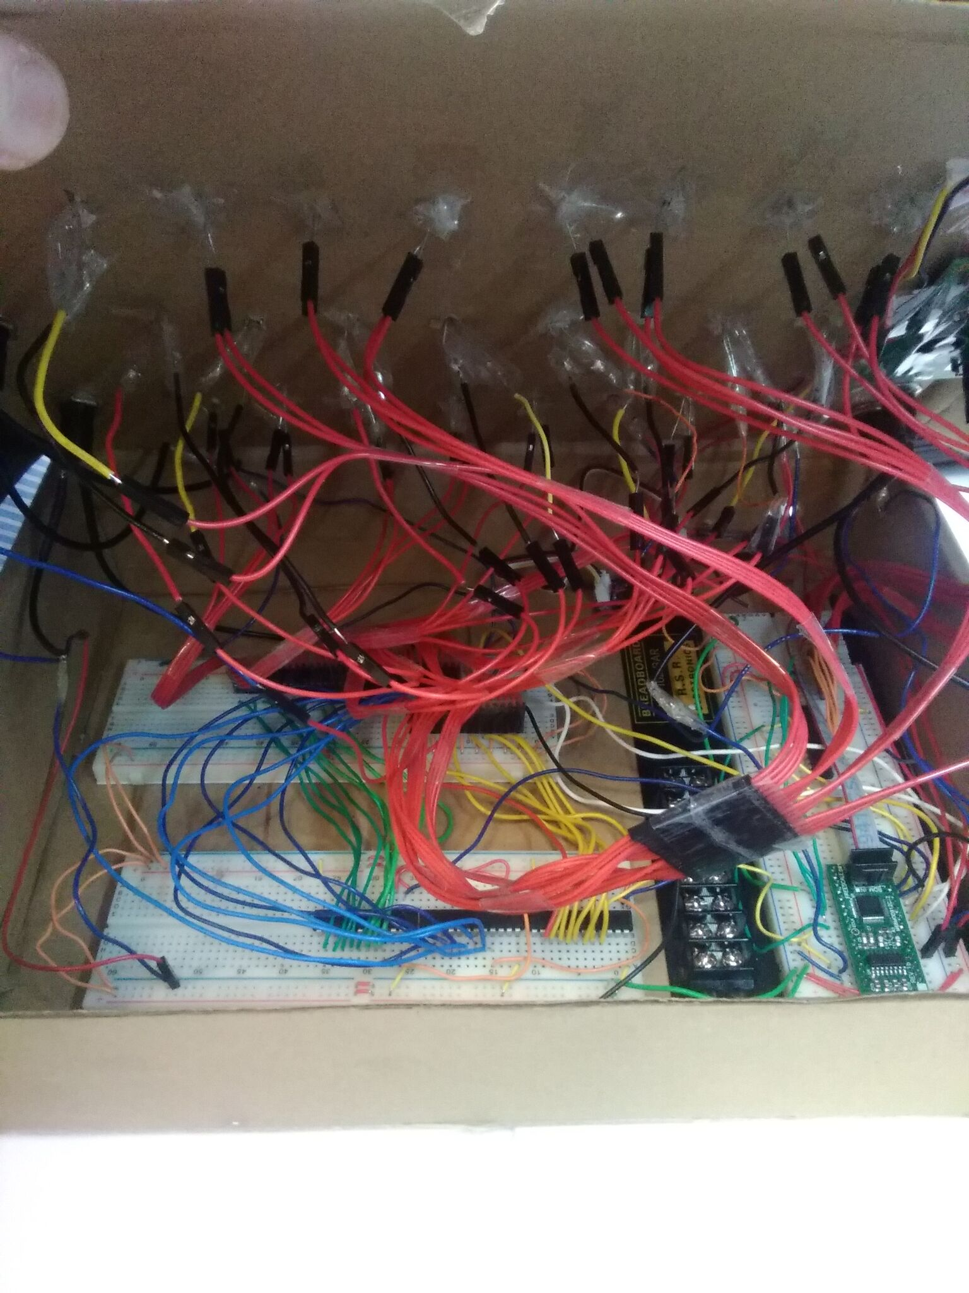

ECE 362 Embedded Microcontroller Mini-Project − Fall 2016
Team <15> – <Mini Music Tap>
Sound Generation:
Difficulty Control:
GND
5V
Analog to Digital
The speed of the music and can be increased and decreased using a potentiometer. A higher potentiometer output increases the rate of the routine interrupt subroutine in control of the music
Printed Circuit Board
Sound is produced by altering the duty cycle of a pulse width modulated output at varying time intervals. The length of these intervals defines the pitch of the sound.
Mini Music Tap is an arcade-style music game with three rows of LEDs that light up in sync with the Super Mario Bros. theme song. The goal of the game is to press the pushbuttons when the bottommost LEDs of the corresponding rows light up. Pressing the correct buttons within the correct interval increases your final score.
A routine interrupt subroutine changes the pitch of the sound being produced, based on what note should played.
Link to Video:
http://youtu.be/reYrb8jZK_c
Digijock(ette)-Strength Digital System DesignTM

